Slide 1
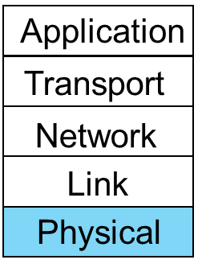
CSC2035 Software Systems Design and Implementation - Networks Part 2 – The Physical Layer

Slide 2
Content
Communications theory
Transmission media
Transmission methods
Line Codes
Examples of Networks

Slide 3
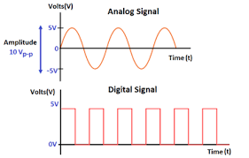
Communications theory (1)
- There are two main types of signals: analogue signal and digital signal
An analogue signal is denoted by sine waves. It uses a continuous range of values to represent information (more suited for measuring natural or physical values)
A Digital signal is denoted by square waves. It uses discrete 0 and 1 to represent information (more suited for computing and digital electronics)
- In the real world there is no such thing as a digital signal, only an analogue approximation. Then how do we generate a square wave?
Notes:
Amplitude A: the height of the wave from the resting position
Wave Length: the distance between successive crests of a wave
Frequency F: The unit of frequency is the hertz (Hz) (Hz is equal to 1 cycle per second).

Slide 4
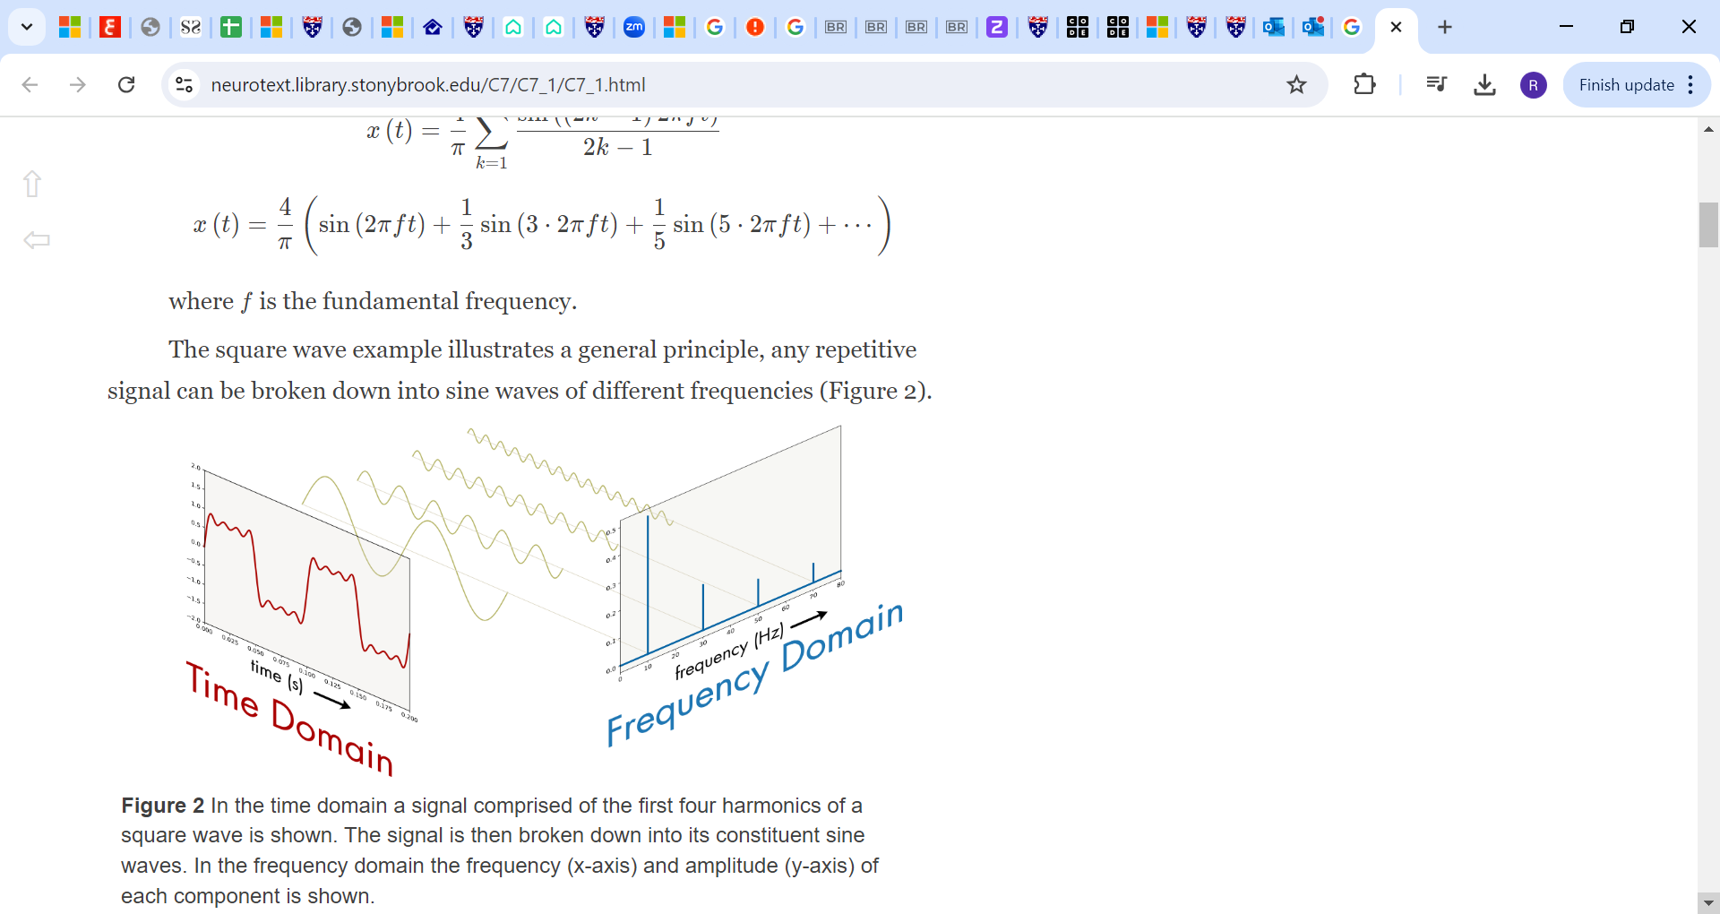
Communications theory (2)
- A square wave, is a sum of different sine waves of different amplitudes and different frequencies.
- In principle it is necessary to add an infinite number of sine waves to produce a perfect square wave
- An approximation is achieved by limiting the number of sine waves? Why?
The number of sine waves you can use is affected by bandwidth
Notes:
- The wave should arrive at the receiver side in a readable format so it can de-code it back to 0s and 1s

Slide 5
Communications theory (3)
Amplitude
Amplitude
time
Frequency
Time domain
Frequency domain
A bandwidth is:
- EE community (analogue): width of the frequency range transmitted without being strongly attenuated (measured in Hz).
- CS community (digital): Maximum data rate of a link (information carrying capacity) (measured in bps) [small “b” is bits].
Notes:
- Each link has a limited bandwidth – there is a cut off point after which higher frequencies cannot pass

Slide 6
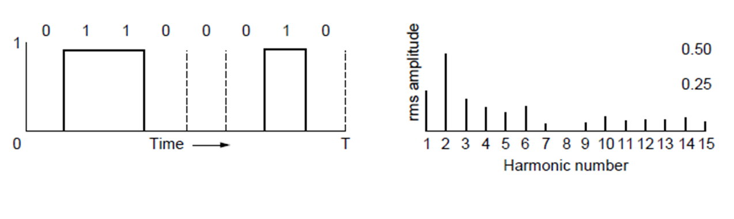
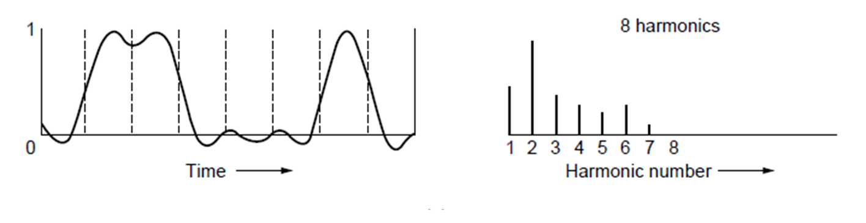
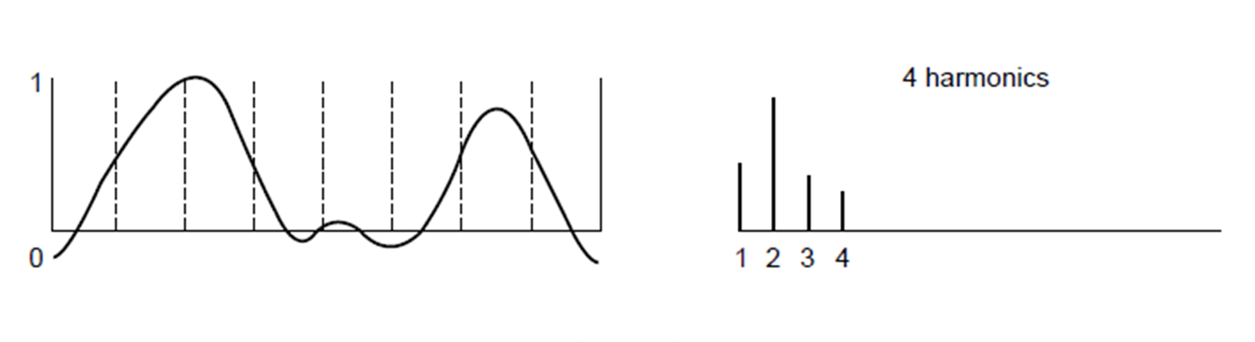
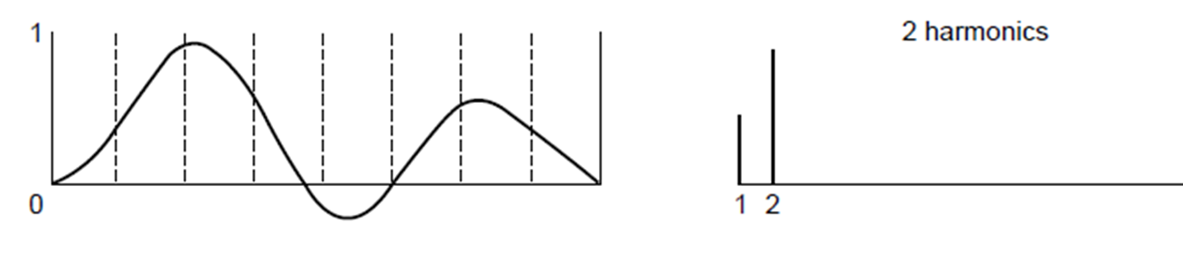
Communications theory (4)
0 1 1 0 0 0 1 0
Lost!
8 waves (half bandwidth)
Unlimited (15) waves
0 1 1 0 0 0 1 0
0 1 1 0 0 0 0 0
2 waves (eighth bandwidth)
4 waves (quarter bandwidth)
Having less bandwidth degrades the signal (reliability margin), so we can do approximation up to a limit
With approximation, I can use the rest of the bandwidth to send other messages
Notes:
- Letter b in Ascii
- If I can send letter b using 4 waves, it is a waste of bandwidth to send it using 15 waves

Slide 7
Maximum Data (bit) Rate of a Channel (bits/sec)
- Nyquist’s theorem, 1924 (noiseless channels)
= 2B for binary (two voltage levels), where B Hz is the Bandwidth
= 2 B log₂V, where V is number of voltage levels
- e.g. by using four voltages, we can send 2 bits at once (the needed bandwidth has been reduced). So why don’t we just keep increasing the number of voltage levels?
Design works as long as the signal at the receiver is sufficiently strong to distinguish the four levels
10v
7v
5v
3v
0v
0v
1
0
1
00
01
10
11
Notes:
- I can send letter b using shorter signal if I use 4 voltage levels

Slide 8
Content
Communications theory
Transmission media
Twisted pair
Coaxial cable
Power lines
Fiber optics cable
The electromagnetic spectrum
Radio transmission
Microwave transmission
Transmission methods
Line Codes
Example of Networks

Slide 9
Transmission media
- The physical layer deals only with nodes that can be reached directly
- The purpose of the physical layer is to transport bits from one node to another. Bits are transmitted as signals over the transmission media
- Media are roughly grouped into guided media (provide a physical path along which the signals are propagated, e.g. copper wires) and unguided media (signals travel through air, vacuum or water, e.g. radio)
Notes:
Unguided media are harder to control, they are scattered everywhere, bump into buildings, absorbed by objects/trees, etc.

Slide 10
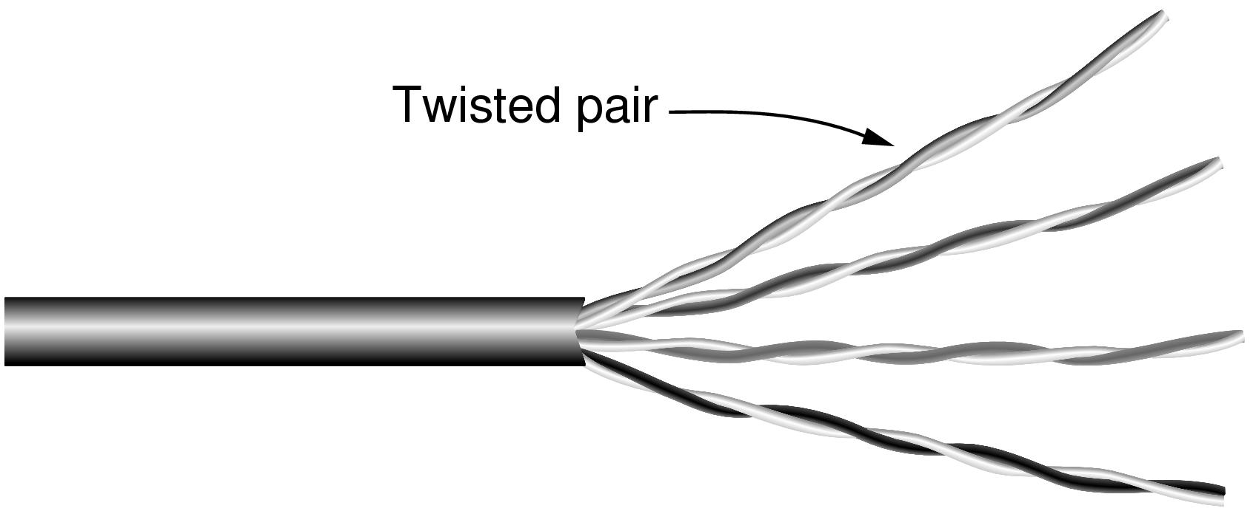
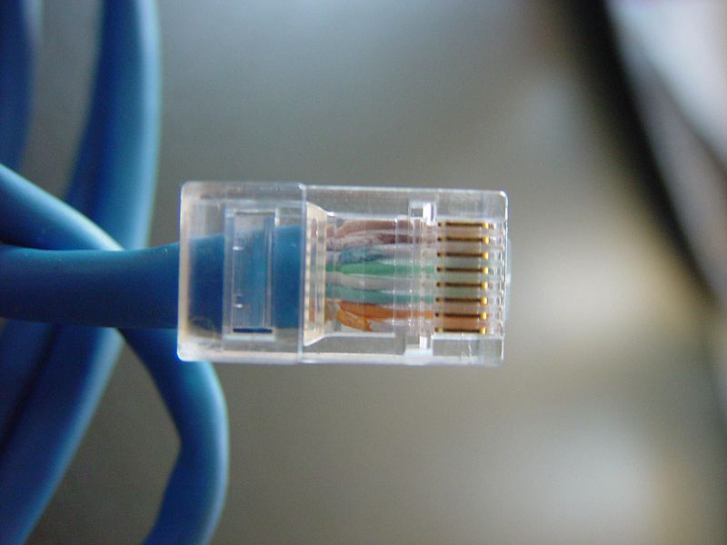
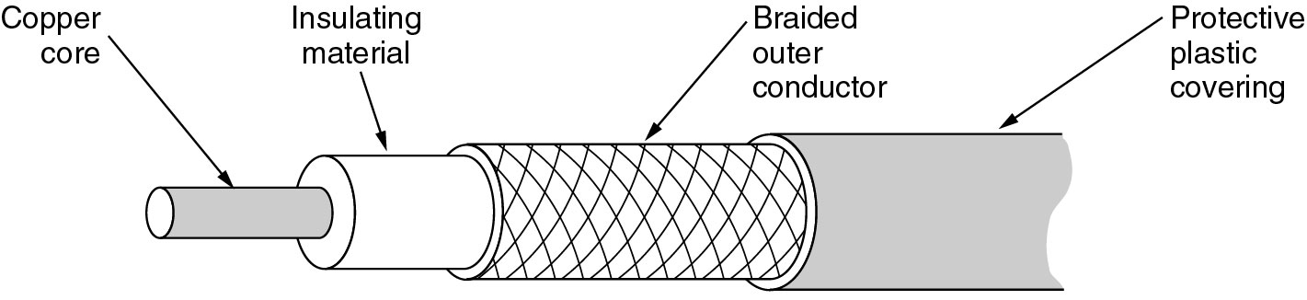
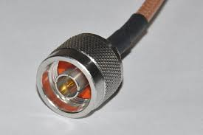
Guided media (1)
- Twisted pair:
Used in telephone lines, LANs
Has four pairs (Not all were used in the old 100 Mbps Ethernet)
Twisting reduces noise as magnetic fields induce currents in opposite directions
Two types: Unshielded Twisted Pair (UTP) and Shielded Twisted Pair (STP) that comes with adadditional shielding
- Coaxial cable
Traditionally used for Ethernet LANs
Used in cable television and MANs
Good shielding reduces noise
More bandwidth for longer distances and higher rates than twisted pair (Capable of sending 1Gbps over 1km)
Notes:
Twisted Pair cables:
Used in the Ethernet
In the past (100 Mbps Ethernet), only two pairs were used (one for sending and one for receiving), the other two were not used
Now (in Gigabit ethernet), all pairs are used for sending and receiving at the same time
The coaxial cable can support longer cable lengths between two devices.

Slide 11
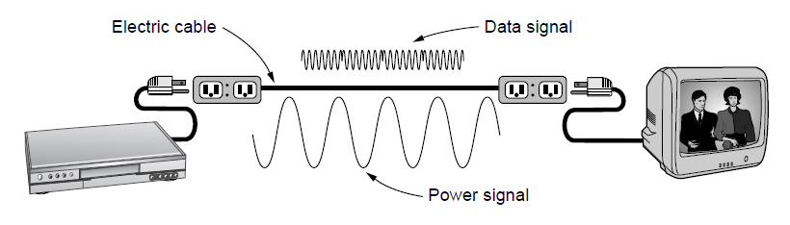
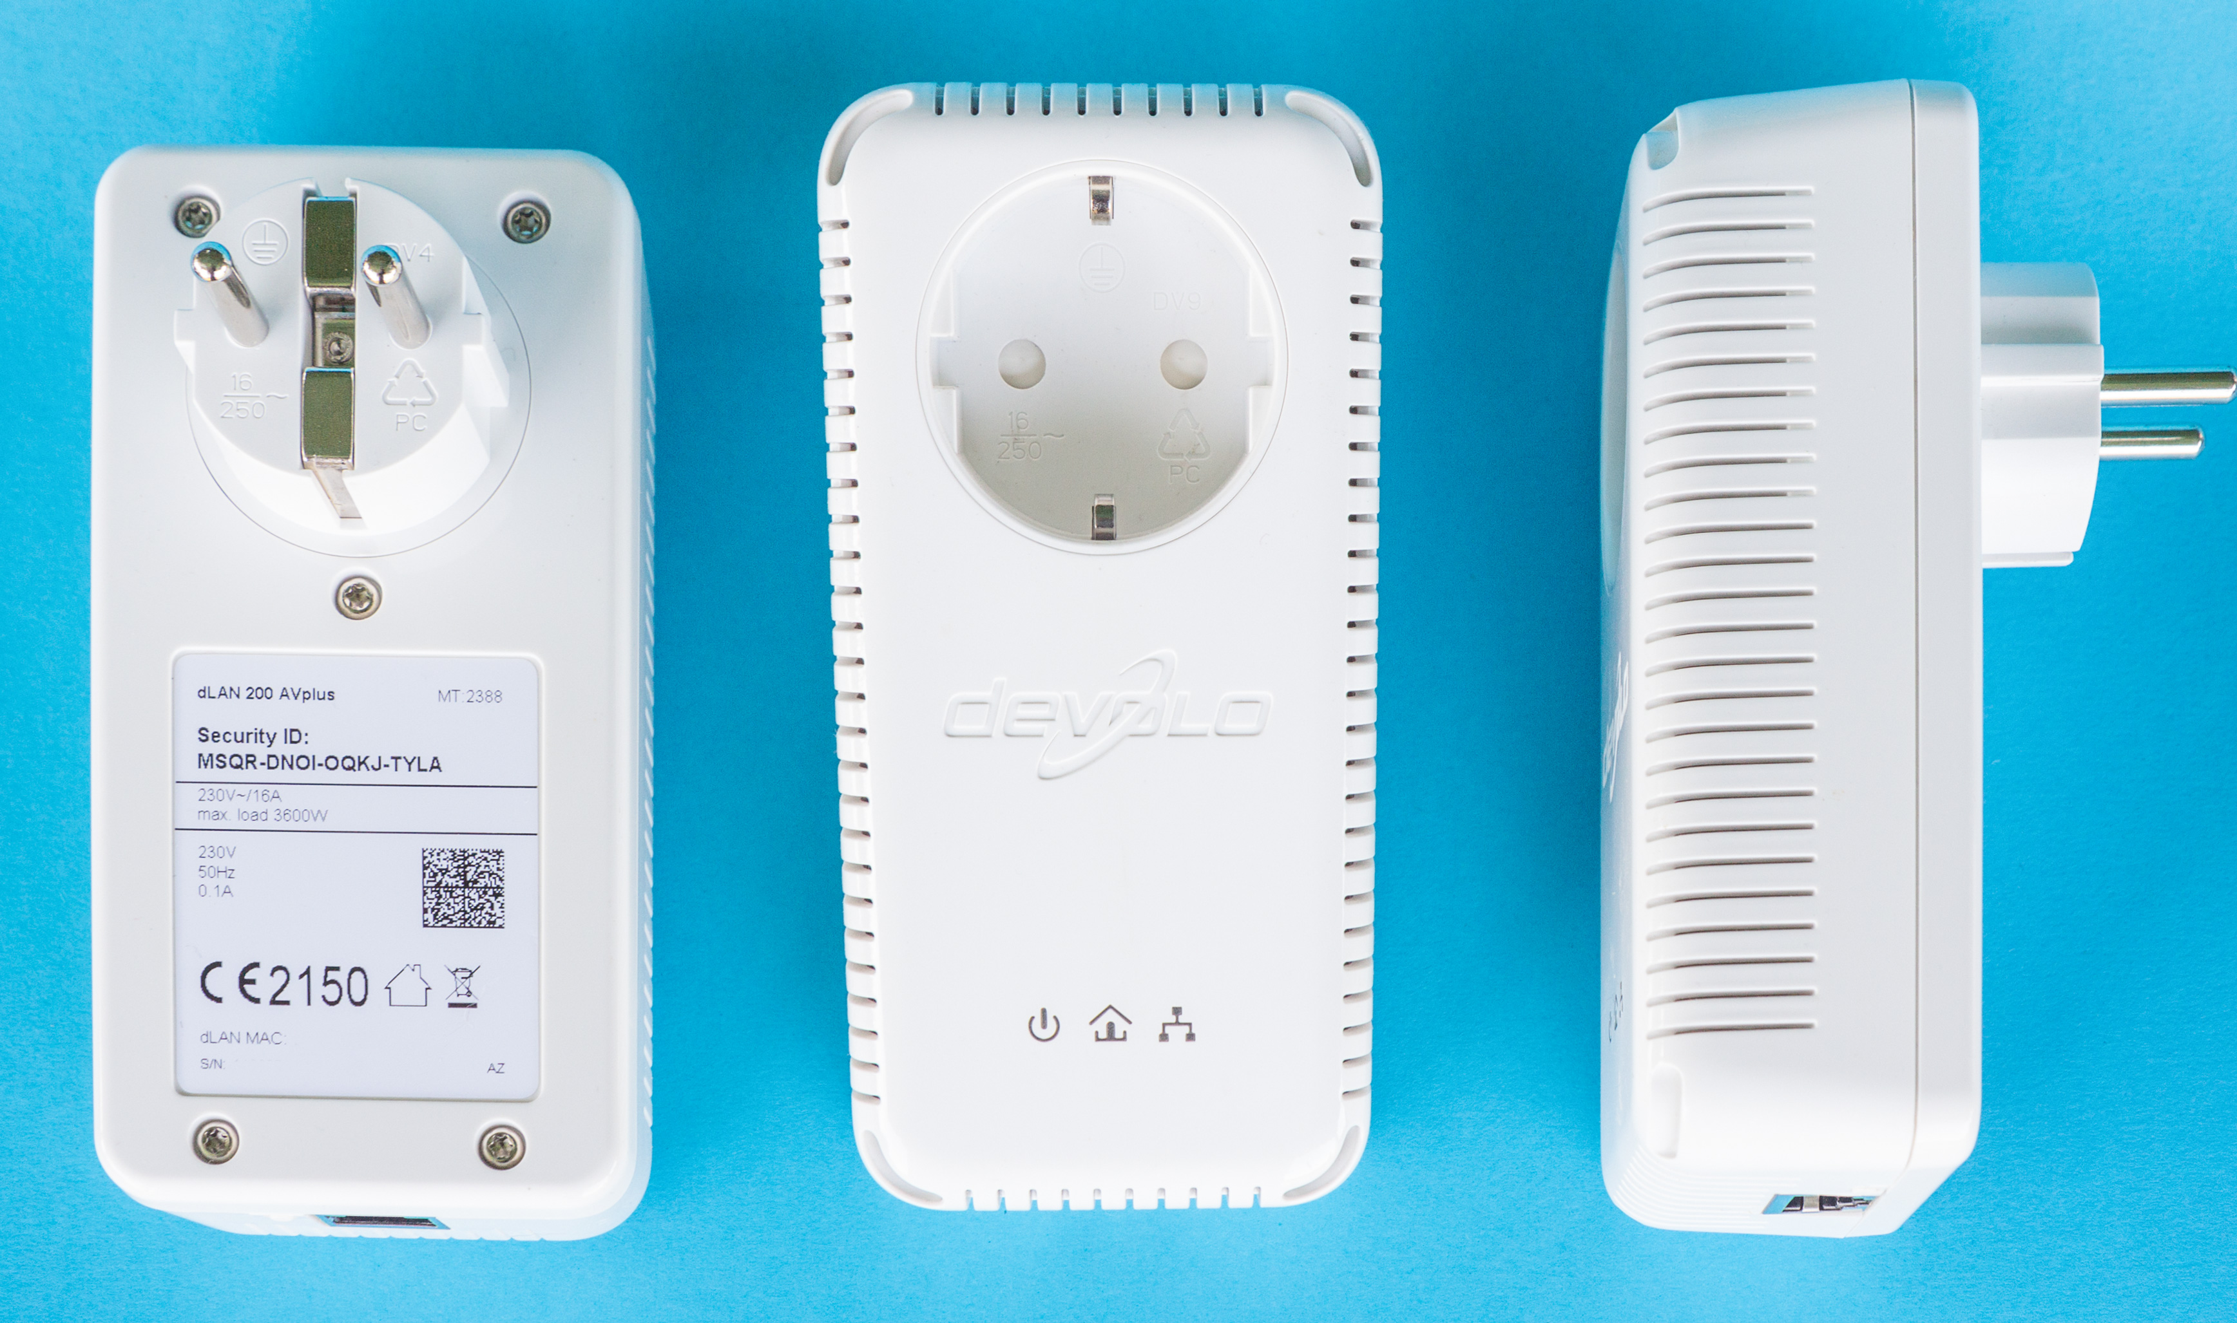
Guided media (2)
- Power Lines:
A network that uses household electrical wiring
Convenient to use, but not great for sending data
Notes:
The electrical signal has a low frequency (50-60HZ) and the wave length is wide, this means we can easily put on top of it another signal that has a higher frequency and smaller wave length
The two adapters can recognise each other and will send and receive data signals
Not ideal because the electrical wires are not well-isolated and they can get affected by noise

Slide 12
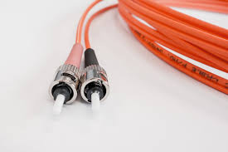
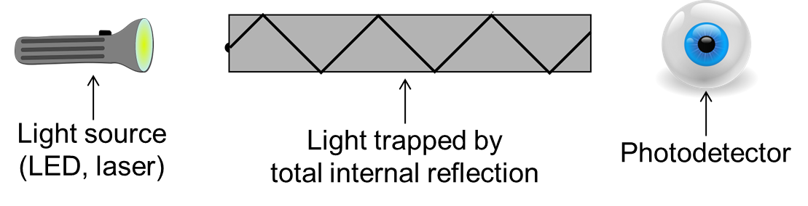
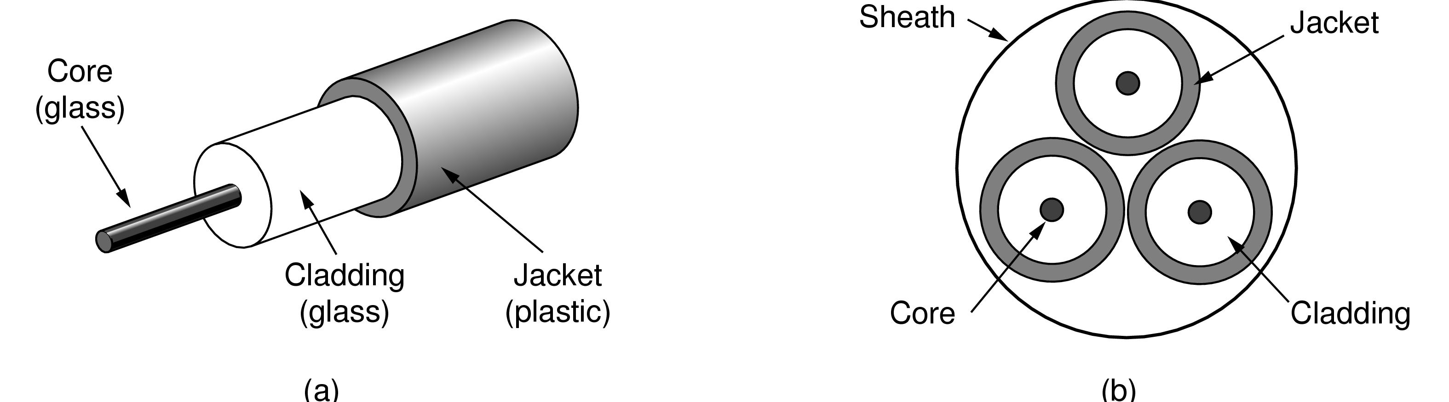
Guided media (3)
- Fiber Optics
Used in long distance ISP links, Fiber-to-the-Home
Common for high rates and long distances (Fiber has enormous bandwidth and tiny signal loss)
Light carried in very long, thin strand of glass
Two types:
Multi-mode: Light can bounce (wider core). Used with LEDs for cheaper, shorter distance links
Single-mode: Core so narrow so light cannot bounce around. Used with lasers. Capable of carrying 100s of Gbps over 100s of kilometers
Side view of a single fiber
Notes:
To build a fiber optic cable you need two types of glasses
One in the core
One for cladding
The speed of light in the core is less than in the cladding so light does not escape
Multi mode cables have wide core that is equal to the thickness of human hair
Single mode cables are more sophisticated, the core diameter is 8-10 micron
Fiber optics are hard to install

Slide 13
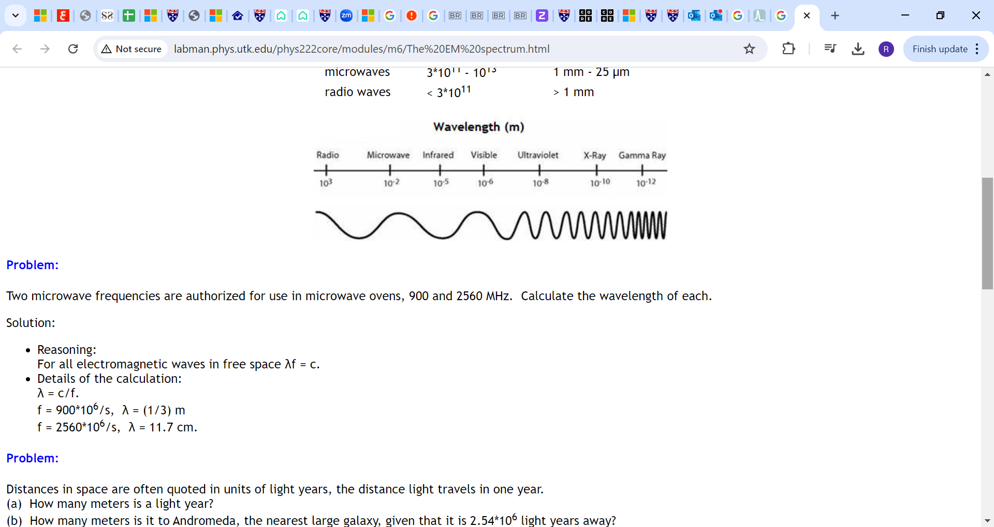
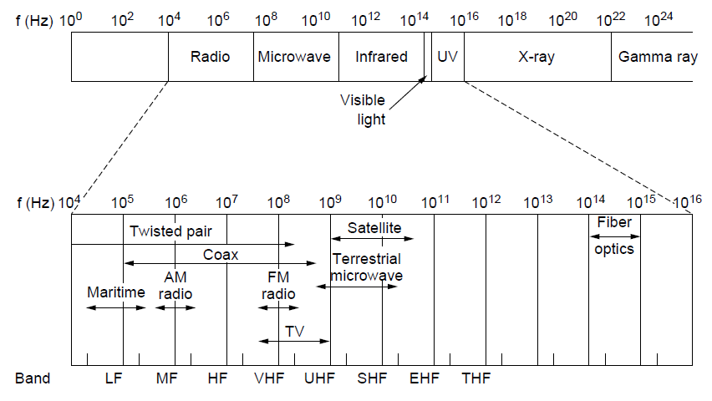
unguided media (1)
The electromagnetic spectrum and its uses for communication
Notes:
- On the left, we have very low frequency signals. On the right, we have very high frequency signals
Low frequency signals have large wavelength, as you increase the frequency, the wavelength will get shorter (we move from several kilometres to a couple of microns)
The higher the frequency, the more data you can send
We cannot send data signals using X-rays and Gamma rays because they are not safe, hard to produce and need clear line of sight

Slide 14
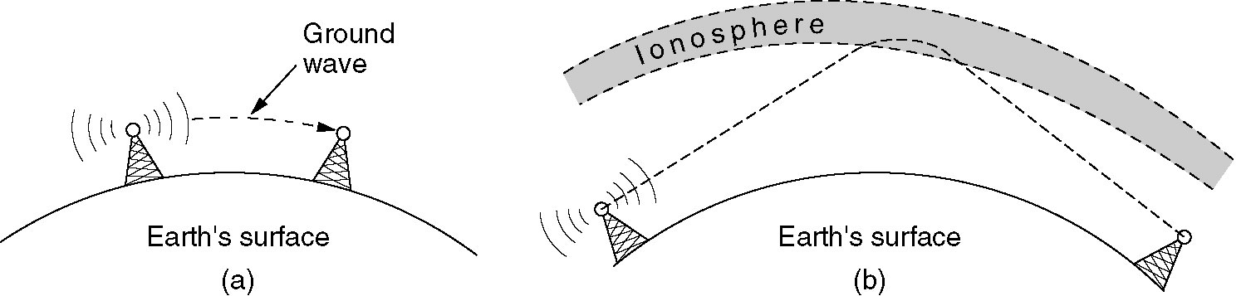
unguided media (2)
Radio Transmission:
Radio signals penetrate buildings well and propagate for long distances
(a) In the VLF, LF, and MF bands, radio waves follow the curvature of the earth (e.g. Maritime, AM radio)
(b) In the HF and VHF bands, the ground waves tend to be absorbed by the earth (FM radio). However, the HF (short wave) band can bounce off the ionosphere
Notes:
LF: signals in this band are used to communicate between submarines (can travel for very long distances)
MF: signals in this band are used to broadcast AM radio (talked programs, all news and all sports)
VHF: used to broadcast FM radio (music)
HF: can be used by military to send more data for longer distances

Slide 15
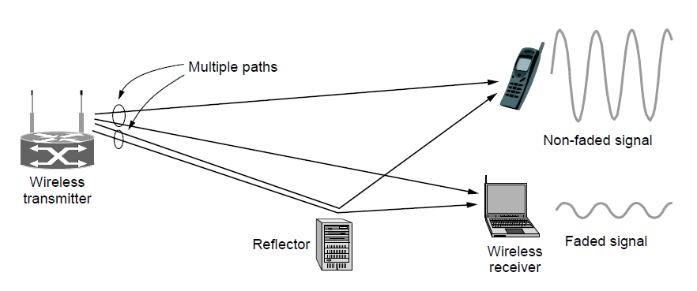
unguided media (3)
Microwave Transmission
Microwaves have much bandwidth and are widely used indoors (WiFi) and outdoors (between masts of 4G, 5G networks, between satellites)
Signal is attenuated/reflected by everyday objects
Strength varies with mobility due multipath fading, etc.
- Infrared Transmission
Used for short-range communication, do not pass-through solid objects
Notes:
Infrared signals need a clear line of sight

Slide 16
Transmission Impairment
- Transmission media are not perfect – the signal at the beginning of the medium is not the same as the signal received at the end of the medium, why?
- A signal is affected by:
Attenuation : Loss of signal strength over distance (we need connectors to strengthen the signal)
Distortion: Alteration of signal shape or form (induced by the attenuation, noise or delay)
Noise (internal or external): The random or unwanted signal that mixes up with the original signal
Attenuation
Distortion
Original signal
Noise
Notes:
Attenuation: signal becomes weak because of the resistance of the link itself
Distortion: if the signal travels longer than the max transmission distance it becomes strongly attenuated. Sever noise might change the shape of a signal.
Noise: internal (thermal noise), external (impulse noise coming from lightning, signals from electrical appliances and cross-talk)

Slide 17
Content
Communications theory
Transmission media
Transmission methods
Simplex v duplex
Parallel v serial
Multiplexing
Line Codes
Examples of Networks

Slide 18
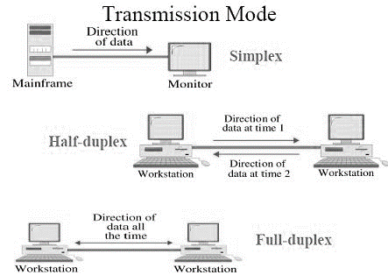
Simplex/duplex Transmission
There are three ways to transmit data:
Simplex - One way communication. Example: keyboard to computer
Half-duplex -Two way communications link, but only one system can talk at a time. Example: walkie-talkie, bus topology Ethernet
Full duplex -Transmit data in both directions simultaneously. Example: telephone. Most communications systems work full-duplex (the extra cost is marginal)

Slide 19
Parallel vs. serial transmission
- Parallel transmission
Transmits a group of bits simultaneously - high bit rate
Expensive over long distances because of need for thicker cable
Synchronisation problem over long distances (bit skew)
- Serial transmission
Transmits bits one after another - slower than parallel transmission
More reliable and cheaper for transmission over long distances
Incurs additional complexity for sending and receiving devices

Slide 20
Multiplexing
- Multiplexing allows the carrying of multiple signals on a single medium (share a channel among users). This allows more efficient use of the transmission medium (better utilization)
- There are three major multiplexing techniques:
Frequency-division multiplexing (FDM)
Time-division multiplexing (TDM)
Code Division Multiple Access (CDMA)

Slide 21
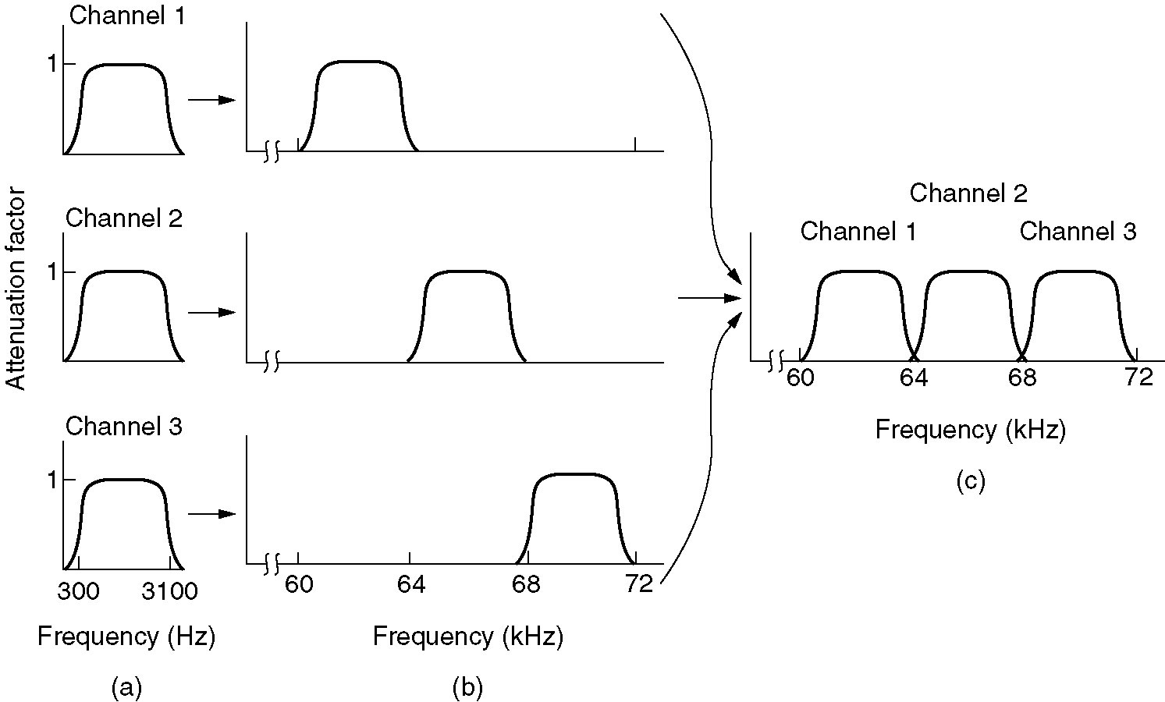
Frequency Division Multiplexing
- Shares the channel by placing users on different frequencies. Takes advantage of the fact that useful bandwidth of the medium exceeds the required bandwidth of a given signal
The original bandwidths (e.g. for voice circuits)
The bandwidths raised in frequency
The multiplexed channel
- Filters used at receiver to separate channels

Slide 22
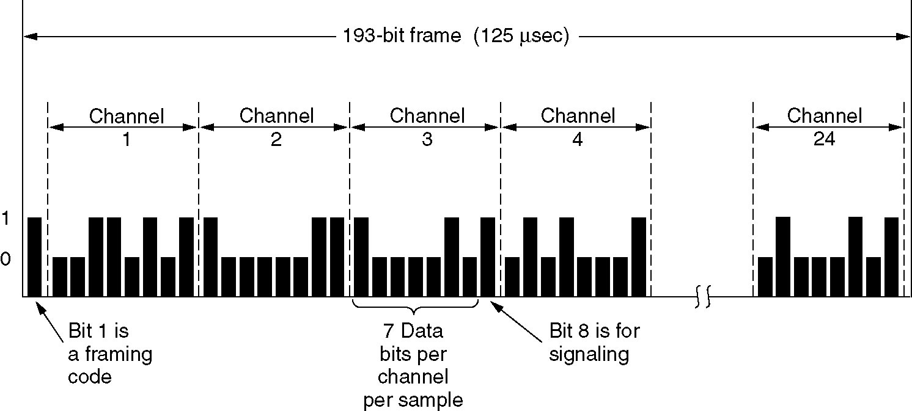
Time Division Multiplexing
- Shares a channel over time. Takes advantage of the fact that achievable bit rate of the medium exceeds the required data rate of a digital signal (Each signal takes up the transmission medium for a little “time slice”)
Time domain
t
Each channel has a time slot for transmission on the link
Notes:
The conversations are taking turns in round robin fashion

Slide 23
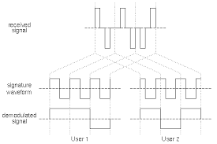
Code Division Multiple Access
- Shares the channel by giving specific code to users. Widely used as part of 3G networks
Received signal
Code
Decoded signal
User 1
User 2

Slide 24
Content
Communications theory
Transmission media
Transmission methods
Line Codes
Examples of Networks

Slide 25
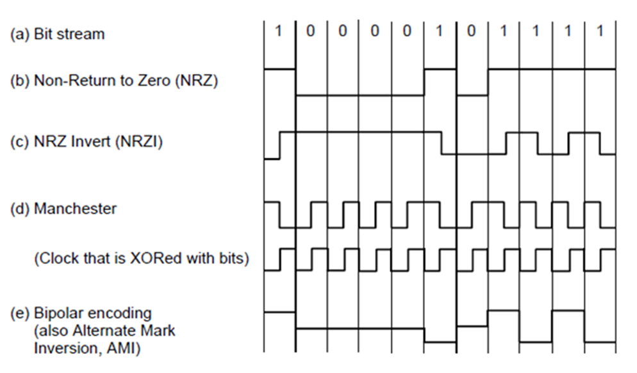
Line Codes: Digital data to digital signal
- Represents bit stream by a digital signal
- NRZ (Non-Return-to-Zero) is the simplest (+1V=“1”, -1V=“0”)
- Transferring a long stream of bits introduces a synchronisation problem. The clocks of the sender and receiver never run exactly at the same speed. How is the receiver going to tell where the bit boundaries are? How many ‘1’ bits are in the picture below?
1
0
time

Slide 26
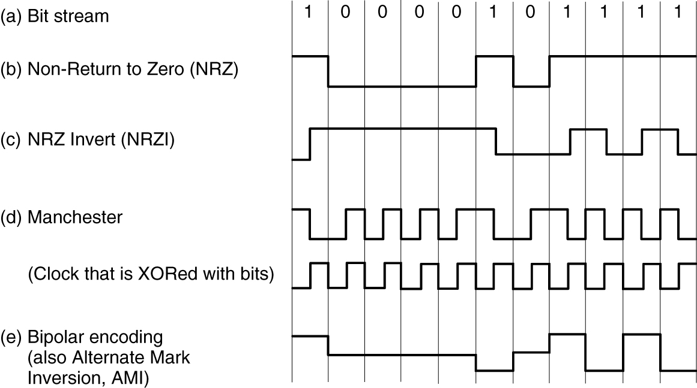
Line Codes - Synchronisation
- Can deal with synchronisation problem by:
Use a separate clock wire. This is only feasible over very short distances
Embed the clock signal into the bit stream. Data is encoded in such a way that there is always a signal transition present for every bit of data. A clock extraction circuit at the receiver uses these transitions to regenerate the clock signal (RZ/Manchester)
Use the bit stream to synchronise the receiver clock occasionally. This requires the guaranteed occasional presence of signal transitions (NRZI)
- We will look at
Manchester Encoding and NRZI
Data Signal
clock
Notes:
In the first approach we are wasting resources and we will end up having the bit skew problem again
Second approach takes up a lot of bandwidth
Third approach depends on the fact that we will never ever end up with a very long sequence of 1s or 0s

Slide 27
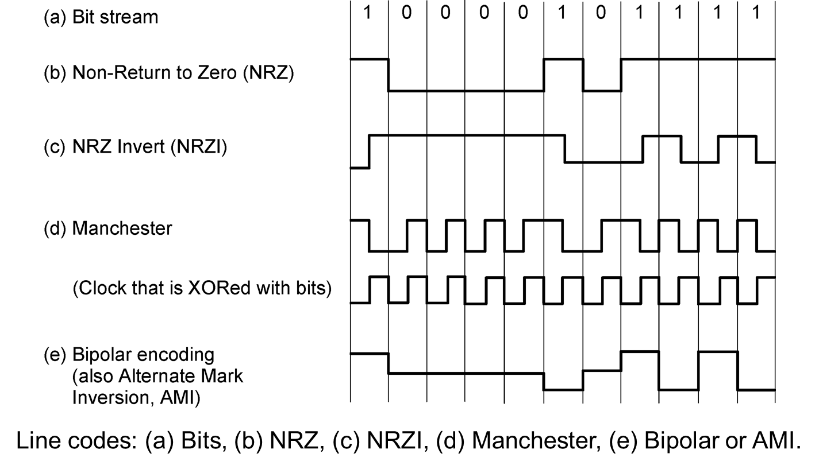
Line Codes – Manchester Encoding
- The direction of change indicates polarity (0/1). The G.E. Thomas convention of Manchester encoding states that:
High-to-low transition (Negative edge) in the middle of the bit is logical 1
Low-to-high transition (Positive edge) in the middle of the bit is logical 0
- Sometimes shown inverted by text books (IEEE convention)
Bit stream
1
0
0
1
clock
Manchester wave
Notes:
Used in the classic ethernet

Slide 28



Manchester Encoding Examples
The following digital signal uses the Manchester encoding scheme. What Binary number does it represent?

Slide 29
Line Codes – Non-Return-to-Zero-Inverted (NRZI) Encoding
NRZI means invert on 1
The presence or absence of change that indicates polarity (0/1)
A change at the bit boundary means logical “1”
No change means logical “0”
- Sometimes shown inverted by text books.
Bit stream
1
0
0
1
NRZI wave
Notes:
Used in serial cables

Slide 30



Line Codes – Non-Return-to-Zero-Inverted (NRZI) Encoding
The following digital signal uses the NRZ-I encoding scheme. What Binary number does it represent?

Slide 31
Content
Communications theory
Transmission media
Transmission methods
Line Codes
Examples of Networks
Communication satellites
Mobile Networks

Slide 32
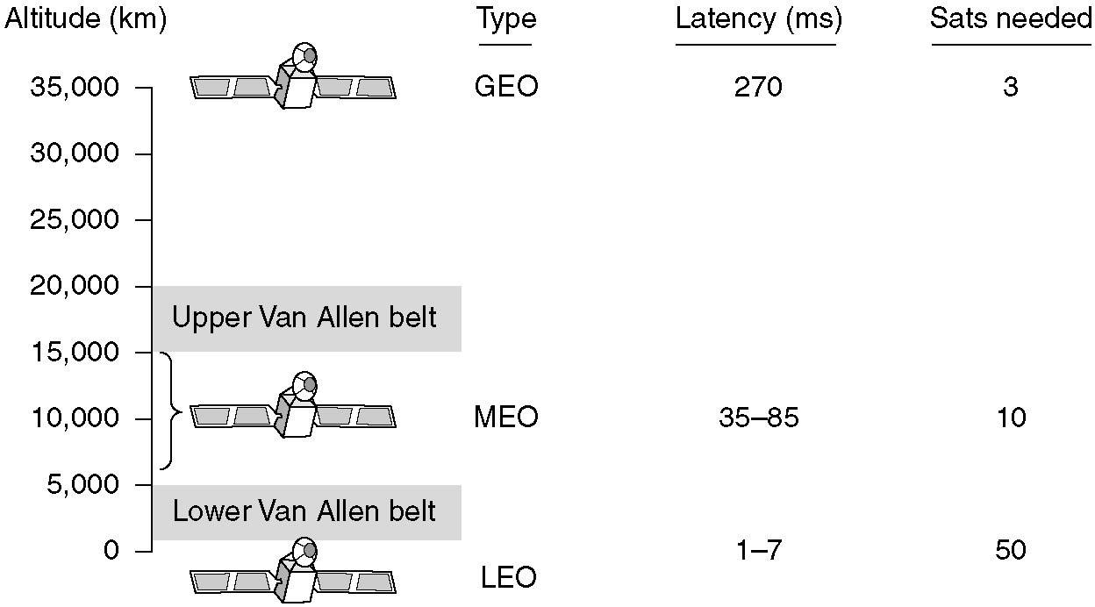
Communication Satellites
Communication satellites and some of their properties, including altitude above the earth, round-trip delay time and number of satellites needed for global coverage
Notes:
GEO (geostationary earth orbit)
MEO (medium Earth orbit)
LEO (low Earth orbit)

Slide 33
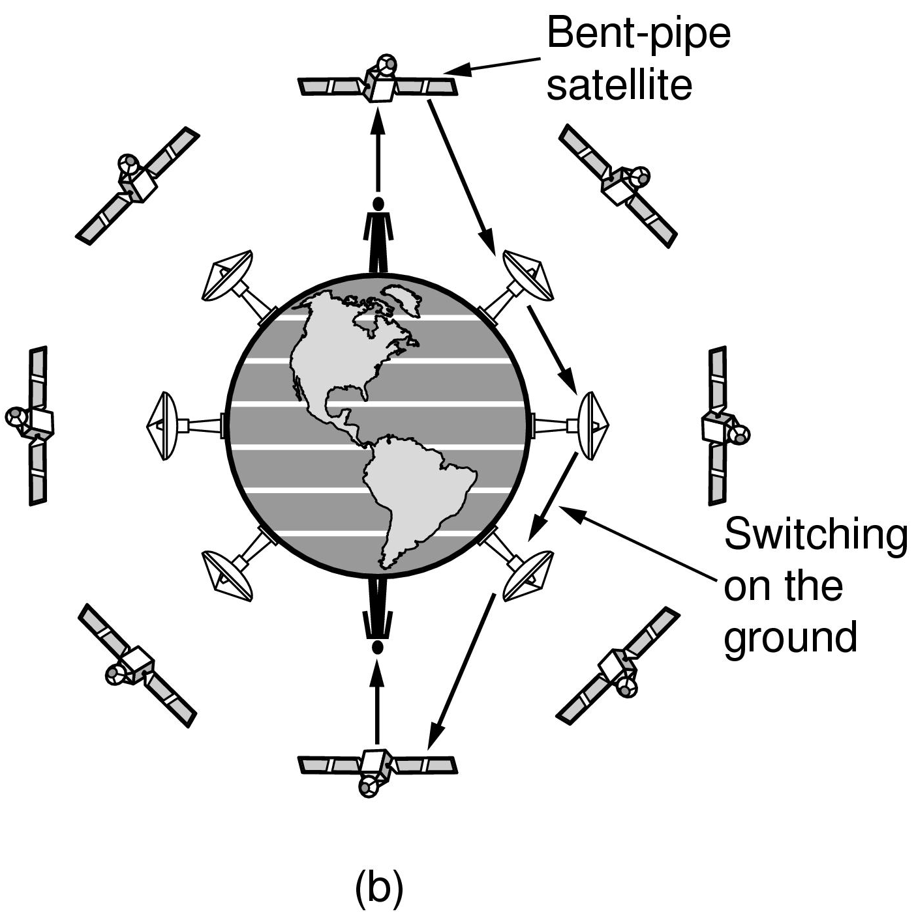
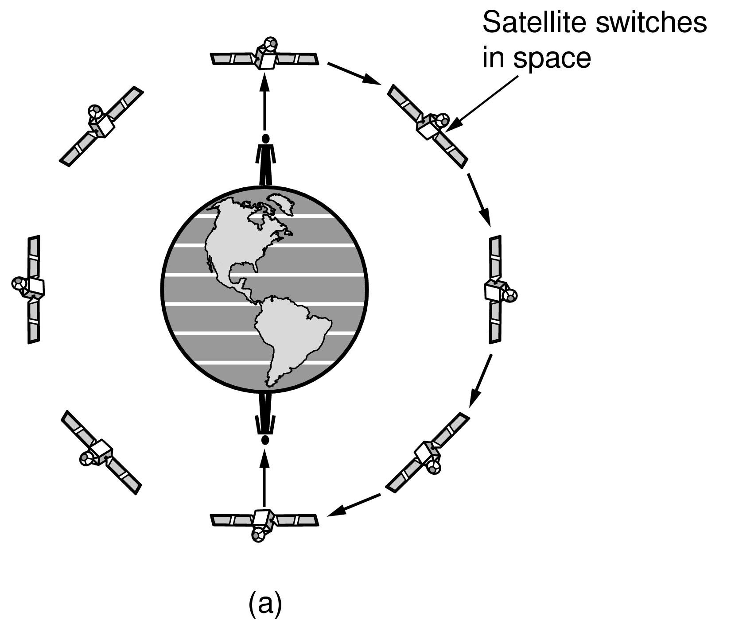
LEO (Low Earth Orbit) Satellites
Relaying in space
Relaying on the ground

Slide 34
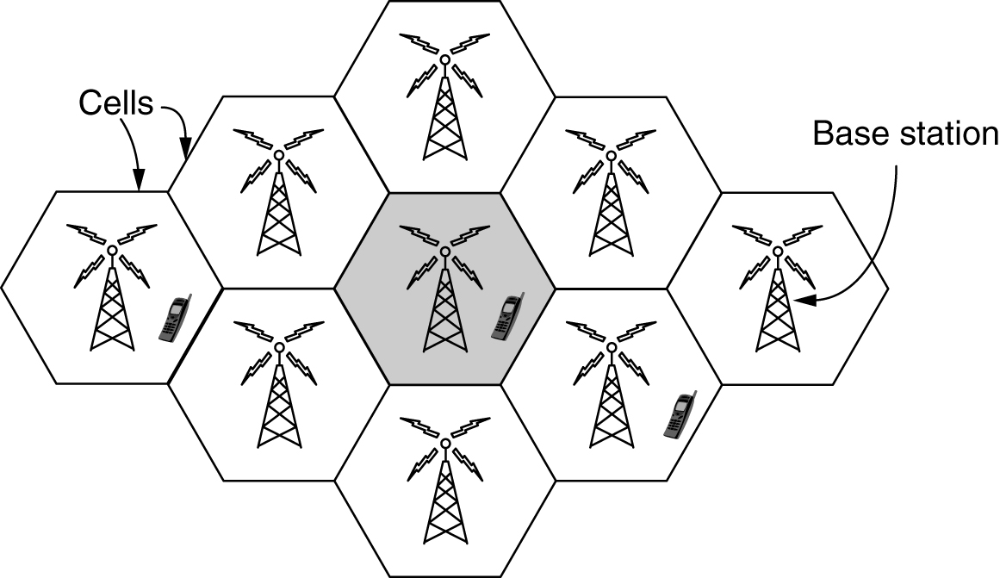
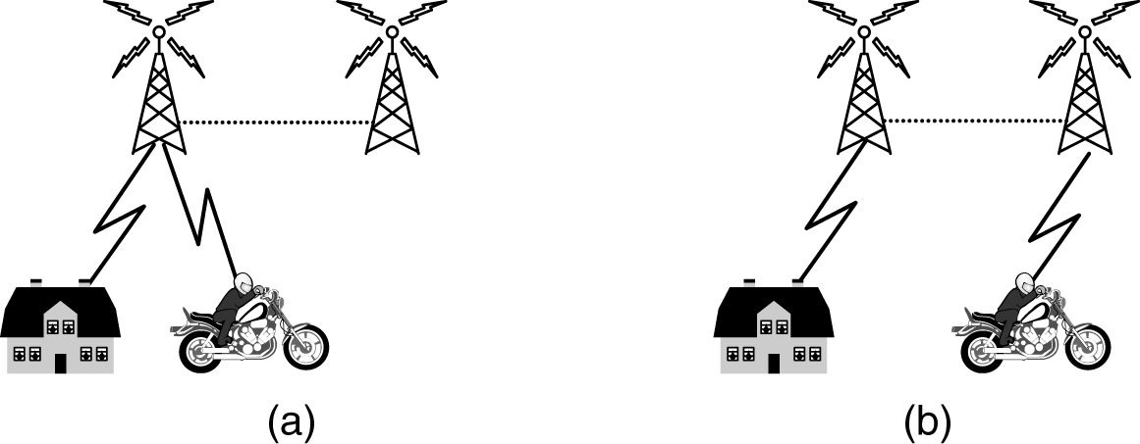
Mobile Telephone System (1)
The world is divided into cells (Frequencies are not reused in adjacent cells)
A mobile phone sends and receives information by radio communication. Radio frequency signals are transmitted from the phone to the nearest base station
- If a person with a mobile phone moves out of one cell and into another, the controlling network hands over communications to the adjacent base station

Slide 35
Mobile Telephone System (2)
- Mobile phone distinct generations:
1G (1980s) Mobiles with Analog Voice (used FDM)
2G (1990s) Mobiles with Digital Voice and offer text messaging (use FDM, TDM)
3G (2000s) Mobiles with Digital Voice and Data (internet, email, etc.)(CDMA)
4G (2010s) Mobiles with Digital Voice and lots of Data (packet switching only)
5G (2019) promising faster speeds Up to 10 Gbps (Increased bandwidth with millimeter waves)
Notes:
Dominant technology in 2G was GSM, the first to use a sim card
5G focused on minimizing latency

